Slide 1

Sarower Ahmmed

Slide 2
JAVA project Structure
Project
Top most
packages
Collection of classes
Class
Blueprint of object
Class
Variable
Holder of Data
ALL JAVA Code
Methods
ALL Selenium CODE
Behavior of object

Slide 3
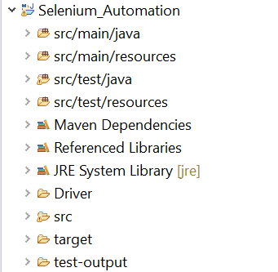
ECLIPSE JAVA project
Project Name
Maven Project Folder /Folder Structure of Maven
Library / JAR file
Additional Library File
Java JDK-JRE File
Browser Driver
Simple Java Project Folder
All Reports and Logs

Slide 4
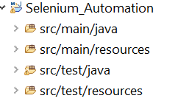
Why maven project has 4 folders ??
Test Code
All Application related file here
All Application related file here
Test Code
Test data & test supporting fie + Cucumber feature file here

Slide 5
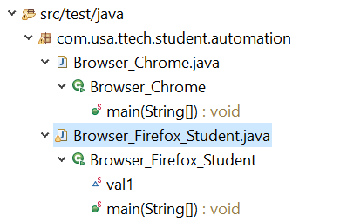
Inside folder
Package
.java file /class code
.class file/ after compiler
Method
Variable

Slide 6
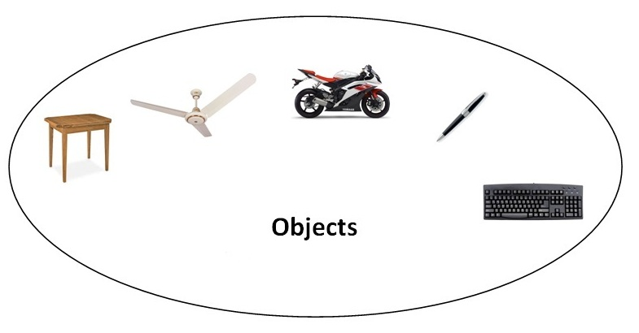
Object
Any entity that has state and behavior is known as an object. For example: chair, pen, table, keyboard, bike etc. It can be physical and logical.

Slide 7

Object
Object means a real word entity such as pen, chair, table etc.
Object-Oriented Programming is a methodology or paradigm to design a program using classes and objects.
It simplifies some concepts:
Object
Class
Inheritance
Polymorphism
Abstraction
Encapsulation
Interface
Constructor

Slide 8
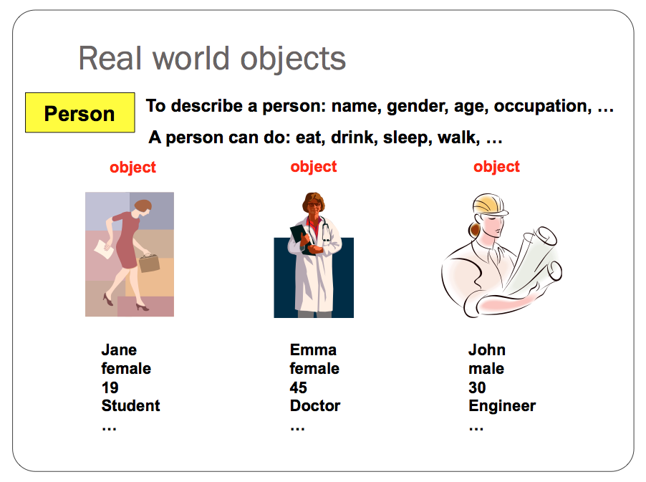

Slide 9
An object has three characteristics:
State: represents data (value) of an object.
Behavior: represents the behavior (functionality) of an object such as deposit, withdraw etc.
Identity: Object identity is typically implemented via a unique ID. The value of the ID is not visible to the external user. But, it is used internally by the JVM to identify each object uniquely.

Slide 10
Ways to initialize object
There are 3 ways to initialize object in java.
By variable / reference variable
By method
By constructor

Slide 11
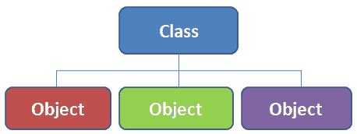
Class
Collection of objects is called class. It is a logical entity.
Its blue print of objects
It is a logical entity.
It can't be physical.

Slide 12
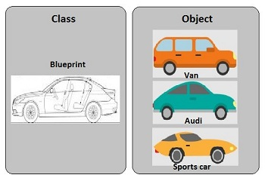

Slide 13
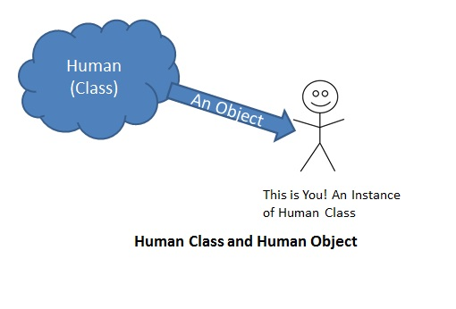
Man/woman
Man/woman= object

Slide 14
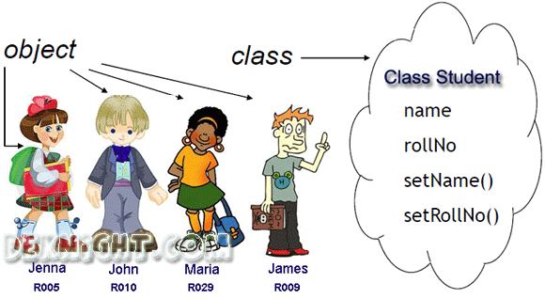

Slide 15
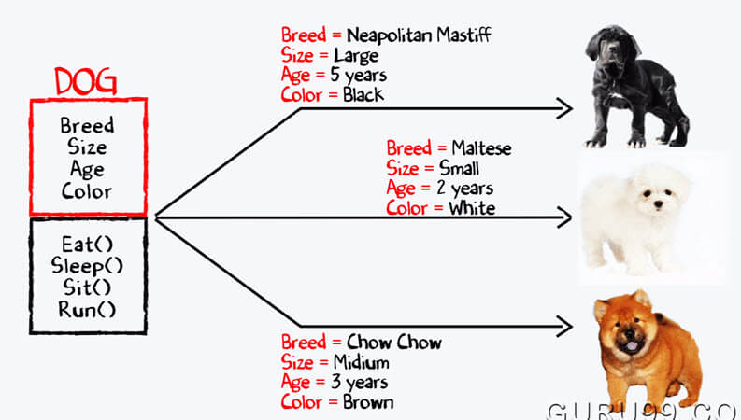

Slide 16

Object
Have some common criteria

Slide 17
Difference between object and class
OBJECT | CLASS
Object is an instance of a class | Class is a blueprint or template from which objects are created.
Object is a real world entity such as pen, laptop, mobile, bed, keyboard, mouse, chair etc. | Class is a group of similar objects.
Object is a physical entity. | Class is a logical entity.
Object is created through new keyword mainly e.g. Student boy=new Student(); | Class is declared using class keyword e.g. class Student{}
Object is created many times as per requirement. | Class is declared once.
Object allocates memory when it is created. | Class doesn't allocated memory when it is created.
There are many ways to create object in java such as new keyword, newInstance() method, clone() method, factory method and deserialization. | There is only one way to define class in java using class keyword.

Slide 18
What are the different ways to create an object in Java?
There are many ways to create an object in java. They are:
By new keyword
By newInstance() method
By clone() method
By deserialization
By factory method etc.

Slide 19
How to create object from class
Student girl= new Student();
Student boy= new Student();

Slide 20
Class Animal{
Animal dog = new Animal();
}
Class Vehicle{
Vehicle truck=new Vehicle();
}

Slide 21
Class
Normal / concreate
Abstract/incomplete
Normal Methods:: which has body and signature
Abstract /incomplete Methods: only have signature but no body

Slide 22
Class in JAVA
Concreate class/ Normal class- contains
Complete method (Method signature/name + method body/description)- mean non-abstract method
No abstract word before class
Instantiation possible- we can create object from this class
No need inheritance

Slide 23
Class in JAVA
2. Abstract class-
Abstract method – only method name/signature no body or description inside
Also contain abstract method
Abstract word before class
Not possible Instantiation - we can not create object from this class
Must inheritance and complete the class by completing the method description

Slide 24
What the meaning in English ?
An abstract or general idea or term apart from specific objects, or actual instances and not realistic.
Definition of abstraction - the quality of dealing with ideas rather than events,

Slide 25
Abstract class in Java
Abstract mean incomplete
A class that is declared with abstract keyword, is known as abstract class in java. It can have abstract and non-abstract methods (method with body).
Before learning java abstract class, let's understand the abstraction in java first.

Slide 26
Inheritance: Java OOPs concept
Parent ➔ child
Genetic code transfer
Same :
Class A ➔extends➔ Class B ➔ extends ➔ Class C

Slide 27
//save by A.java
package pack;
public class A{
protected void msg(){System.out.println("Hello");}
}
//save by B.java
package mypack;
import pack.*;
class B extends A{
public static void main(String args[]){
B obj = new B();
obj.msg();
}
}
Output:Hello

Slide 28
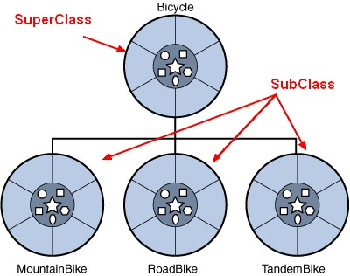
Super class and Sub class ??
1st class/ main class/parent class- called SUPER class
Extended class/2nd class/child class- called SUB class

Slide 29
A class in Java can contain:
Variable
methods
constructors
nested class and
interface

Slide 30
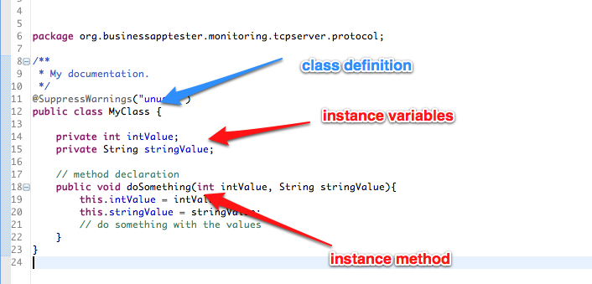

Slide 31
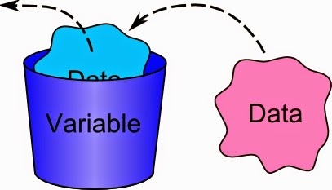
Variable
It’s a container to hold data.
An address or an index to some space of computer memory which hold data.
Called variable as it can be change.
Each variable has name and type according to data type it holds

Slide 32
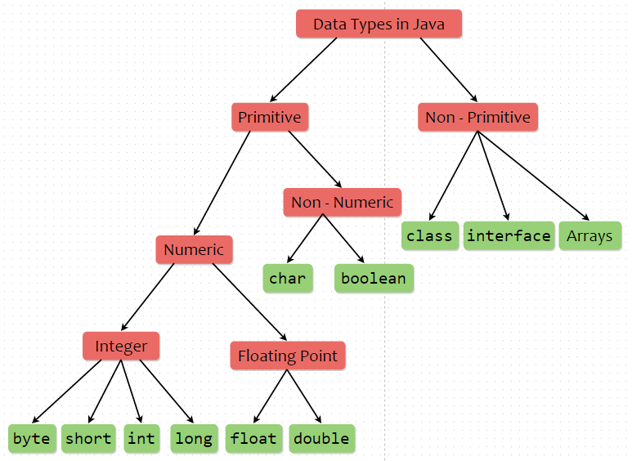
String

Slide 33
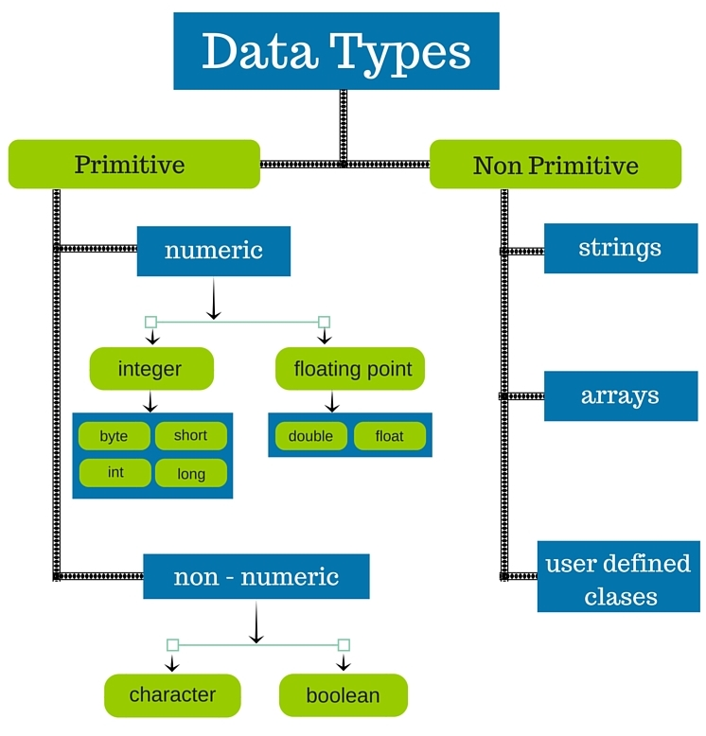

Slide 34
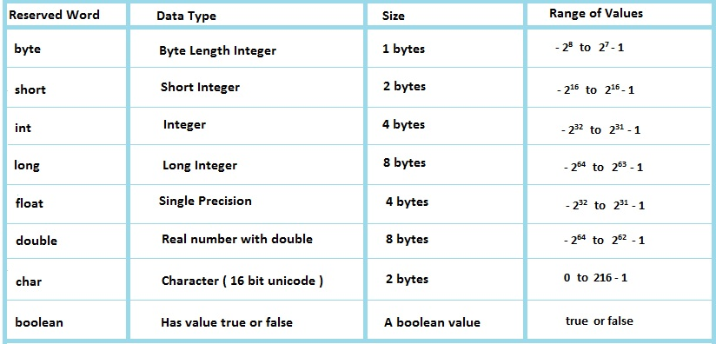
How to calculate Range of value in variable/data: -(2to power n -1) to (2 to power n-1)-1
Like -128 to 127(n = data size)

Slide 35
According to size
Byte type= 1 byte
Short type= 2 byte
Integer = 4 byte
Double = 8 byte
Long type=8 byte
Float type= 4 byte
Boolean=True/false

Slide 36
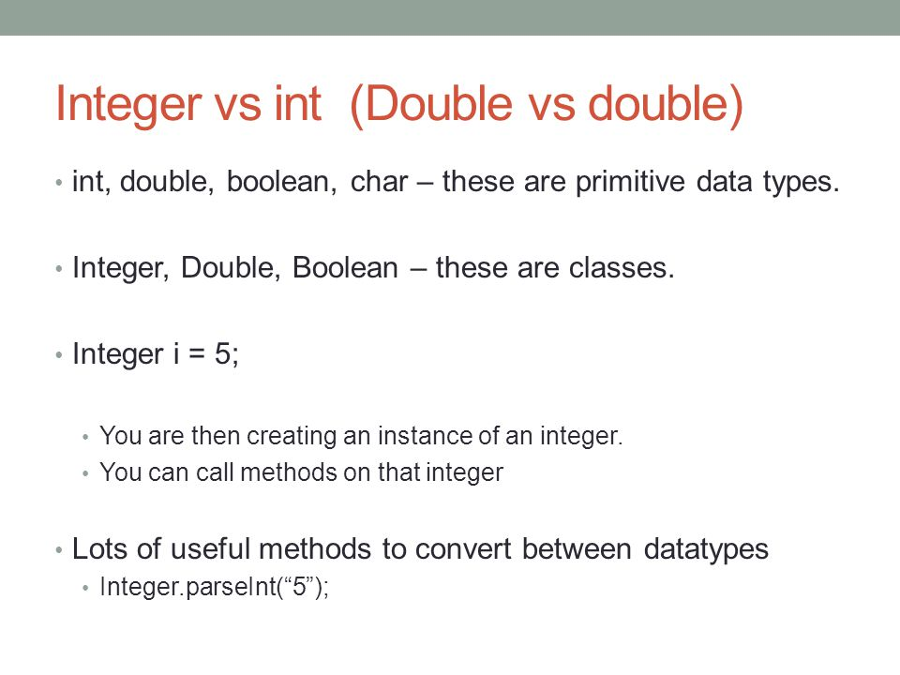
Double | double | Integer | int
Wrapper class | Primitive data | Wrapper class | Primitive data

Slide 37
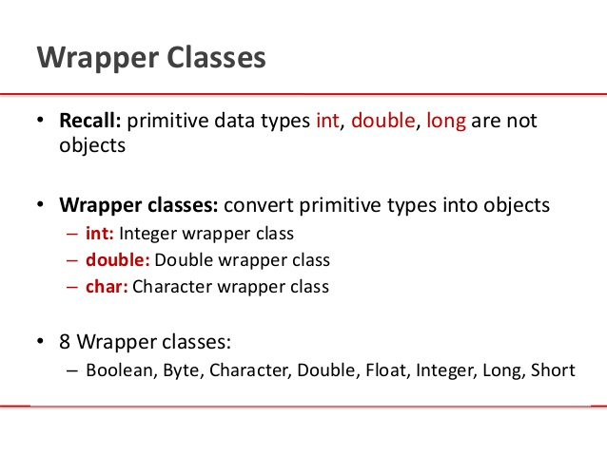

Slide 38
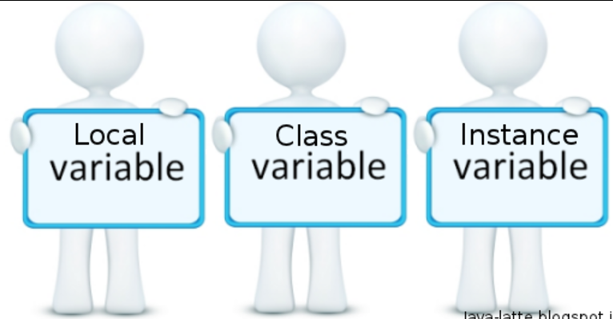
Type of variance during coding
3 kind of variable in java:
Another name of class variable is static variable

Slide 39
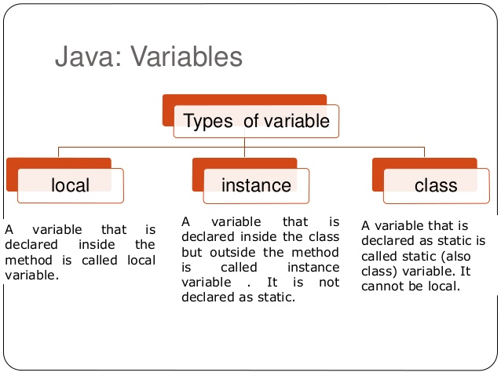

Slide 40
Static/ class level variable | Instance variable | Local variable
Inside class but outside methods | Inside class but outside methods | Inside methods
Use static word | No static | No static
Static method only handle it | Static or non-static methods | Static or non-static methods
Interface use it | Constructor use it | Only method use it

Slide 41
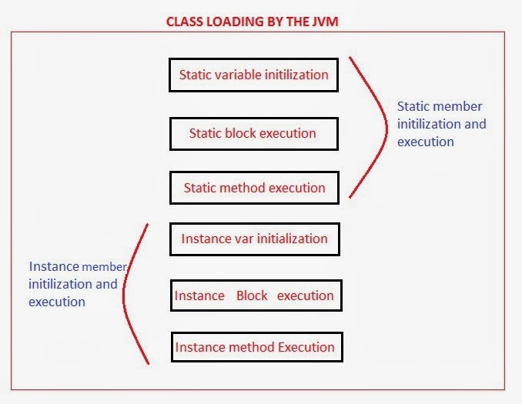

Slide 42
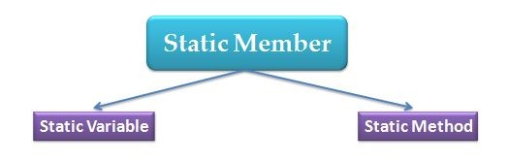
Static word in java
Static mean class level
It read after class by JVM
No need to create object to call it
So we call and use it directly without object
Static variable
Static method
Static interface

Slide 43
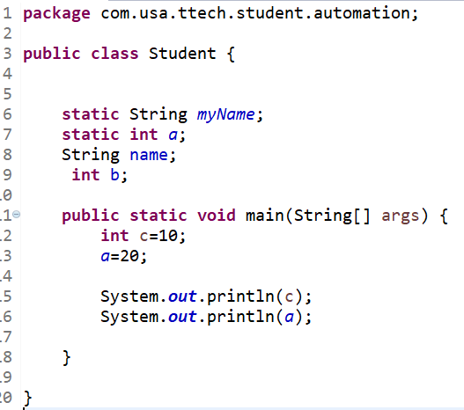
Static Variable
Instance Variable
Local Variable

Slide 44
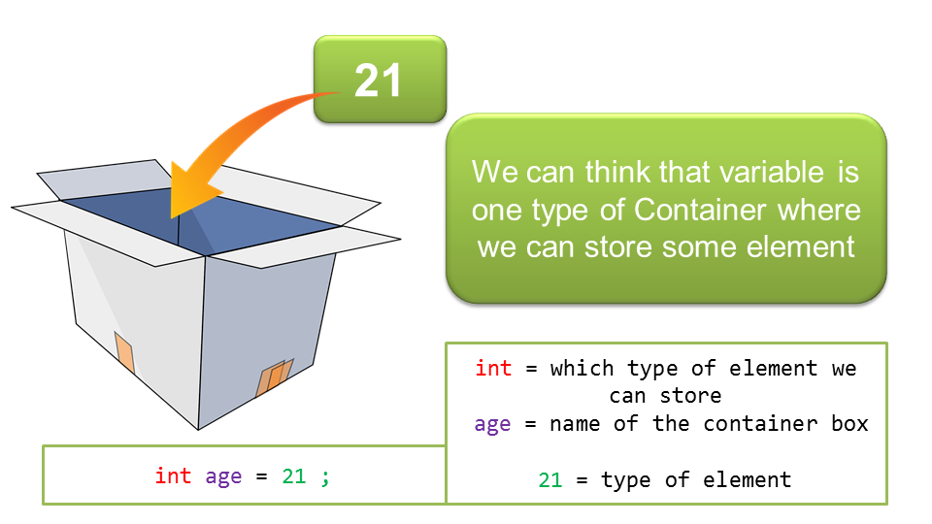

Slide 45
a
Int a
Name of container
Variable Declaration
10
Variable Initialization
Int a
= 10 ➔
Put value/date

Slide 46
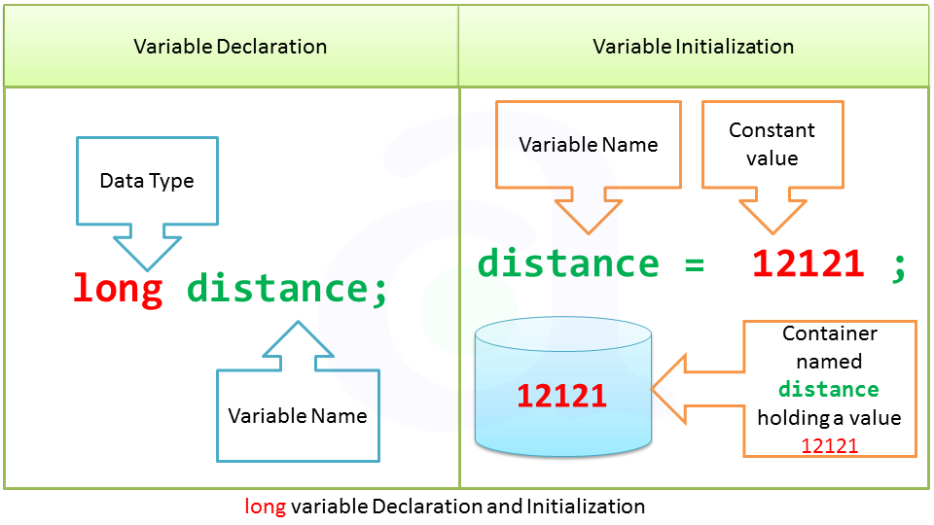

Slide 47
int a=10;
double b=10.25;
String username= “ sarower”;
String password= “ sarower123# ”;
boolean c = true ;
WRONG : if u mismatch data type
int a= “ sarower123# ”;
double b= true ;
String password= 10 ;==➔ wrong
String password= “10 ” ; ➔ Right
boolean c = 10.25;

Slide 48
Java Variable data type
Int can handle only number ,no fraction
Double can handle fraction
String can handle – character/number/special sign but
double coat “ StringName” must

Slide 49
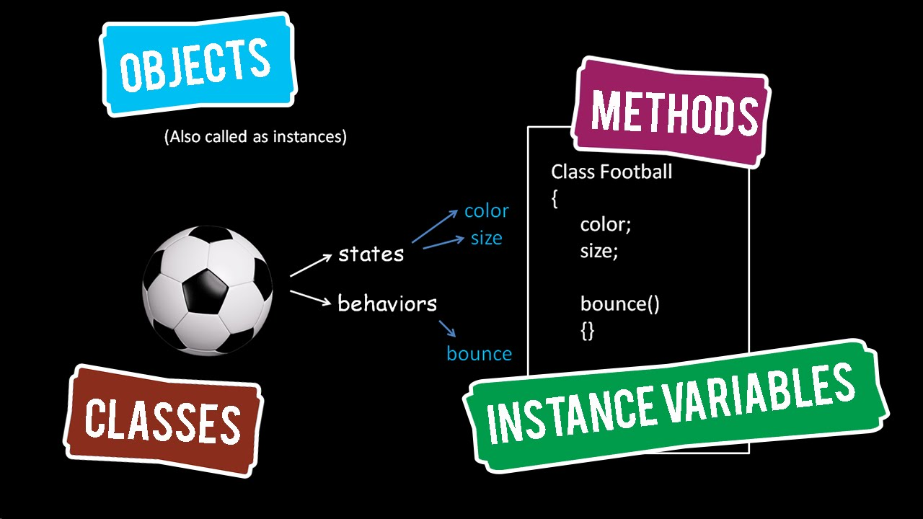
Methods

Slide 50
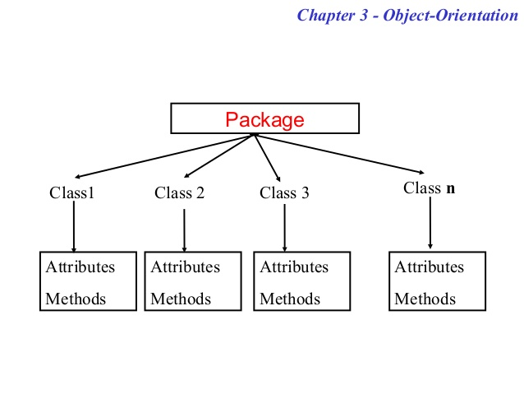

Slide 51
public Class Student{
Int age;
String name;
Public void running(){
age=10;
name= sarower;
Student boy =new student();
}
}

Slide 52
Method in JAVA
Concreate method- contains
Method name /signature
Method description or body
Abstract method-
Abstract method – only method name/signature but
No body or description inside
If a class contain a abstract method than class convert automatically abstract class

Slide 53
Types of Method | Why name | Static variable | Non -static/instance variable | class
Static Method | Static word used | Yes | No | Normal
No static Method | No Static | Yes | Yes | Normal
Void /return nothing | Void word | Yes | Yes | Normal
Non-Void/return something | No void | Yes | Yes | Normal
Main Methods | Static void main | Yes | No | JVM only run main method
Abstract method | No inside description | Nothing inside as no description | Nothing inside | Abstract class

Slide 54
Abstract method
Nothing inside the method name as no description
Only method signature present buy no body or description.
The class which contain a abstract method is called abstract class
The word abstract means incomplete
Abstract class must be extend another class and incomplete/abstract method must be complete……..other wise 2nd class will be abstract too as method not complete

Slide 55
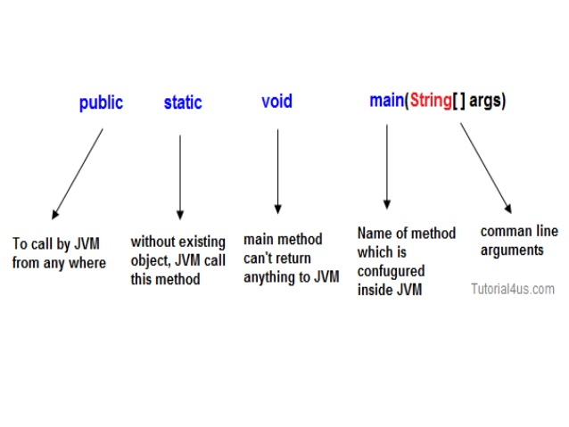

Slide 56
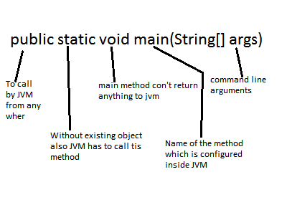

Slide 57
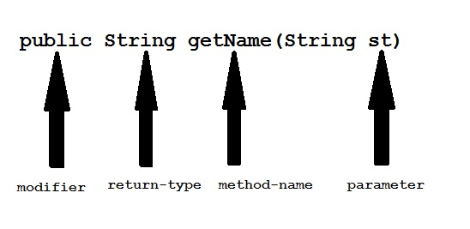

Slide 58
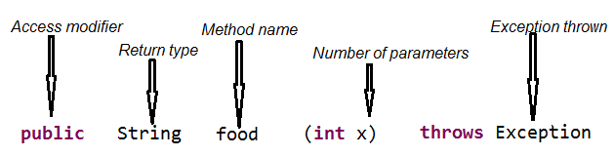

Slide 60
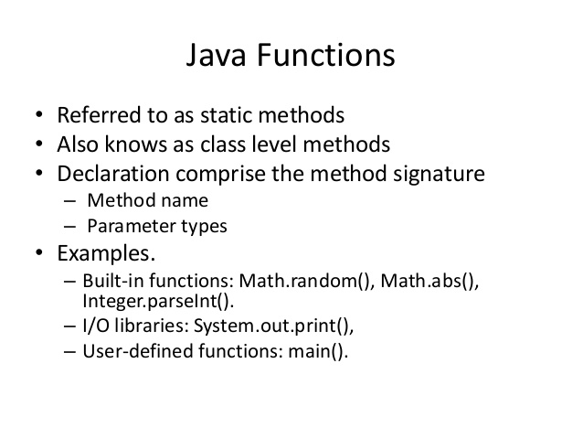

Slide 61
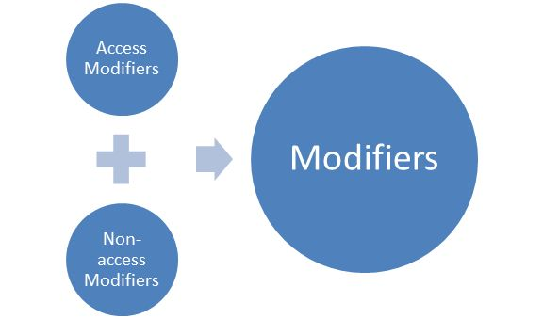

Slide 62
Type
Access Modifier
Non-Access Modifier
Public
Default
Private
protected
Final
Abstract
Static
Strictfp
Native
Synchronized
Transient

Slide 63
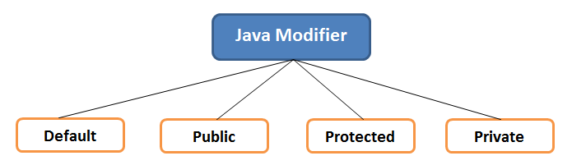

Slide 64
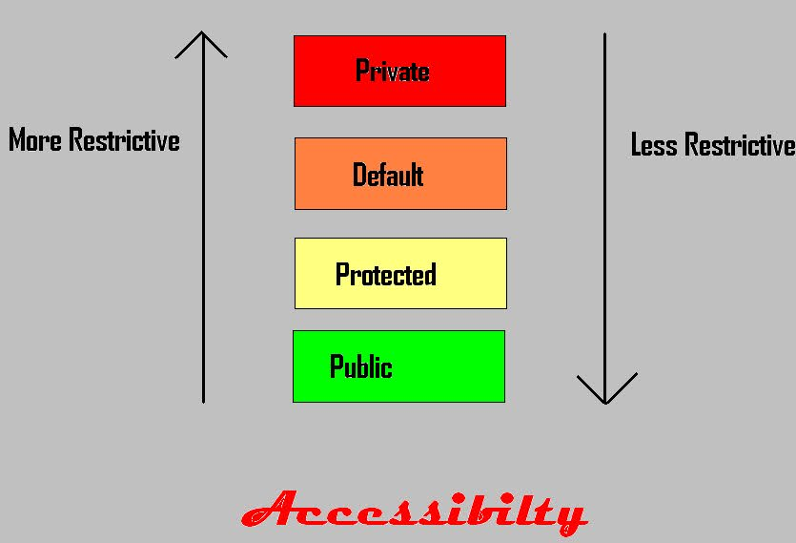

Slide 65
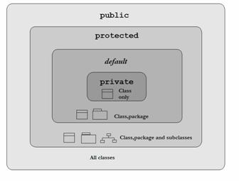

Slide 66


Slide 67
Package 1
Package 2
Class 1
Class 2
Other Class/Sub class 1
Subclass 2(class2 extends class1)
Public

Slide 68

Default / Natural property

Slide 69
Package 1
Package 2
Class 1
Class 2
Other Class/Sub class 1
Subclass 2(class2 extends class1)
default
The default modifier is more restrictive than protected

Slide 70


Slide 71
Package 1
Package 2
Class 1
Class 2
Other Class/Sub class 1
Subclass 2(class2 extends class1)
Protected

Slide 72


Slide 73
Package 1
Package 2
Class 1
Class 2
Other Class/Sub class 1
Subclass 2(class2 extends class1)
Private

Slide 74
Access Modifier | within class | within package | outside package by subclass only | outside package
Private | Y | N | N | N
Default | Y | Y | N | N
Protected | Y | Y | Y | N
Public | Y | Y | Y | Y

Slide 75
Example of public access modifier
//save by A.java
package pack;
public class A{
public void msg(){System.out.println("Hello");}
}
//save by B.java
package mypack;
import pack.*;
class B{
public static void main(String args[]){
A obj = new A();
obj.msg();
}
}
Output:Hello

Slide 76
In this example, we have created two packages pack and mypack. We are accessing the A class from outside its package, since A class is not public, so it cannot be accessed from outside the package.
Example of default access modifier
//save by A.java
package pack;
class A{
void msg(){System.out.println("Hello");}
}
//save by B.java
package mypack;
import pack.*;
class B{
public static void main(String args[]){
A obj = new A();//Compile Time Error
obj.msg();//Compile Time Error
}
}
In the above example, the scope of class A and its method msg() is default so it cannot be accessed from outside the package.

Slide 77
he protected access modifier is accessible within package and outside the package but through inheritance only(subclass).
//save by A.java
package pack;
public class A{
protected void msg(){System.out.println("Hello");}
}
//save by B.java
package mypack;
import pack.*;
class B extends A{
public static void main(String args[]){
B obj = new B();
obj.msg();
}
}
Output:Hello

Slide 78
The private access modifier is accessible only within class.
class A{
private int data=40;
private void msg(){System.out.println("Hello java");}
}
public class Simple{
public static void main(String args[]){
A obj=new A();
System.out.println(obj.data);//Compile Time Error
obj.msg();//Compile Time Error
}
}

Slide 79
Non Access Modifiers in Java
Final
Abstract
Static
Strictfp
Native
Synchronized
Transient

Slide 80
Final Non Access Modifiers
Final modifiers are applicable to :
Class
Method
Instance Variable
Local Variable
Method arguments
Final Class :
A Class when set to final cannot be extended by any other Class.
Example: A String Class in java.lang package
Final Method :
A Method when set to final cannot be overridden by any subclass.
Final Variable :
When a variable is set to final, its value cannot be changed. Final variables are like constants.
Example : public static final int i = 10;

Slide 81
Abstract Non Access Modifier
Keyword: abstract means incomplete
Abstract modifiers are applicable to:
Class
Method
Abstract Class:
An abstract Class can have abstract Methods. A Class can also be an abstract class without having any abstract Methods in it. If a Class has an abstract Method , the Class becomes an abstract Class.
Abstract Method :
Abstract Methods are those Methods which does not have a body but only a signature.
Example : public abstract void method();

Slide 82
The Static Modifier
The static keyword is used to create variables
Only one copy of the static variable exists regardless of the number of instances of the class.
Static variables are also known as class variables. Local variables cannot be declared static.

Slide 83
Static Methods
he static keyword in java is used for memory management mainly. We can apply java static keyword with variables, methods, blocks and nested class. The static keyword belongs to the class than instance of the class.
The static can be:
variable (also known as class variable)
method (also known as class method)
block
nested class

Slide 84
Java static method
If you apply static keyword with any method, it is known as static method.
A static method belongs to the class rather than object of a class.
A static method can be invoked without the need for creating an instance of a class.
static method can access static data member and can change the value of it.

Slide 85
class Student9{
int rollno;
String name;
static String college = "ITS";
static void change(){
college = "BBDIT";
}
Student9(int r, String n){
rollno = r;
name = n;
}
void display (){System.out.println(rollno+" "+name+" "+college);}
public static void main(String args[]){
Student9.change();
Student9 s1 = new Student9 (111,"Karan");
Student9 s2 = new Student9 (222,"Aryan");
Student9 s3 = new Student9 (333,"Sonoo");
s1.display();
s2.display();
s3.display();
}
}
Test it Now
Output:111 Karan BBDIT
222 Aryan BBDIT
333 Sonoo BBDIT

Slide 86
Another example of static method that performs normal calculation
//Program to get cube of a given number by static method
class Calculate{
static int cube(int x){
return x*x*x;
}
public static void main(String args[]){
int result=Calculate.cube(5);
System.out.println(result);
}
}
Test it Now
Output:125

Slide 87
Restrictions for static method
There are two main restrictions for the static method. They are:
The static method can not use non static data member or call non-static method directly. this and super cannot be used in static context.
class A{
int a=40;//non static
public static void main(String args[]){
System.out.println(a);
}
}
Test it Now
Output:Compile Time Error

Slide 88
Q) why java main method is static?
because object is not required to call static method if it were non-static method, jvm create object first then call main() method that will lead the problem of extra memory allocation
Since the main method is static Java virtual Machine can call it without creating any instance of a class which contains the main method.
4. Anything which is declared in class in Java comes under reference type and requires object to be created before using them but static method and static data are loaded into separate memory inside JVM called context which is created when a class is loaded. If main method is static than it will be loaded in JVM context and are available to execution

Slide 89
Why main method is public in Java
Any method or variable which is declared public in Java can be accessible from outside of that class. Since the main method is public in
Java, JVM can easily access and execute it.

Slide 90
Why the main method is void in Java Since the main method in Java is not supposed to return any value, it's made void which simply means main is not returning anything. Summary: 1. The main method must be declared public, static and void in Java otherwise, JVM will not able to run Java program.

Slide 91
Java static block
Is used to initialize the static data member.
It is executed before main method at the time of classloading.
Example of static block
class A2{
static{System.out.println("static block is invoked");}
public static void main(String args[]){
System.out.println("Hello main");
}
}
Test it Now
Output:static block is invoked Hello main

Slide 92
Can we execute a program without main() method?
Ans) Yes, one of the way is static block but in previous version of JDK not in JDK 1.7.
class A3{
static{
System.out.println("static block is invoked");
System.exit(0);
}
}
Test it Now
Output:static block is invoked (if not JDK7)
In JDK7 and above, output will be:
Output:Error: Main method not found in class A3, please define the main method as:
public static void main(String[] args)

Slide 93


Slide 94
